Slide 1
Zentangle
Who What? And How To…

Slide 2
What is a Zentangle?
A zentangle is drawing made from simple structured, deliberate, repeated patterns.
Zentangles are typically draw inside an enclosed shapes.

Slide 3
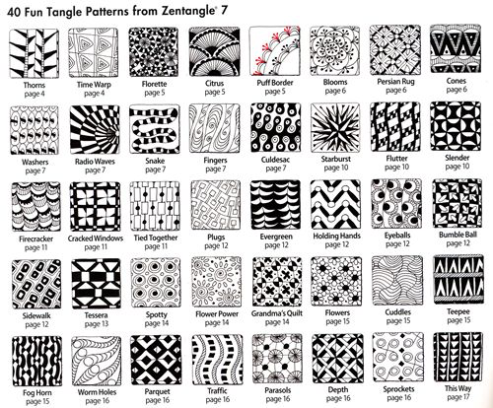
Zentangle Patterns
There are many different Zentangle patterns. Here are just a few.

Slide 4
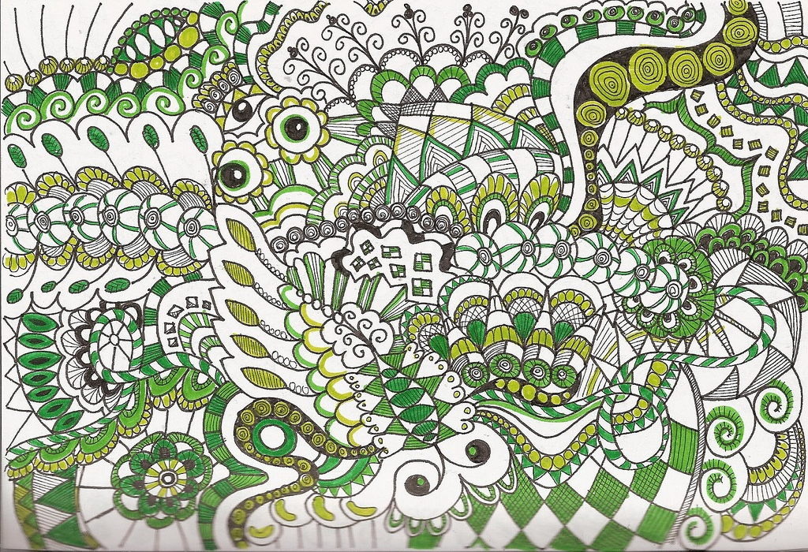
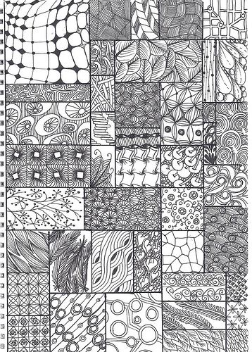
Zentangle Examples

Slide 5
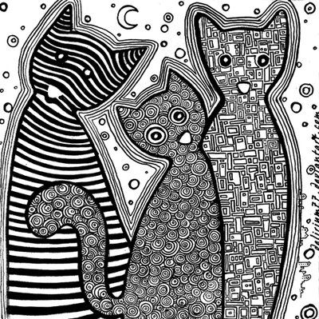
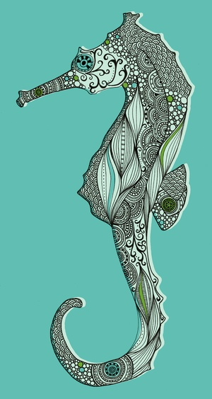
More Examples

Slide 6
Zentangle Practice
It is helpful to draw Zentangles on a grid when you first start out. This way you keep your patterns even.
We will start with patterns in squares. Follow along on your sheet as we go along.
Then you can “free style” some zentangle patterns in organic shapes, such as an animal.

