Slide 1
Wrap Your Mummy

Slide 2
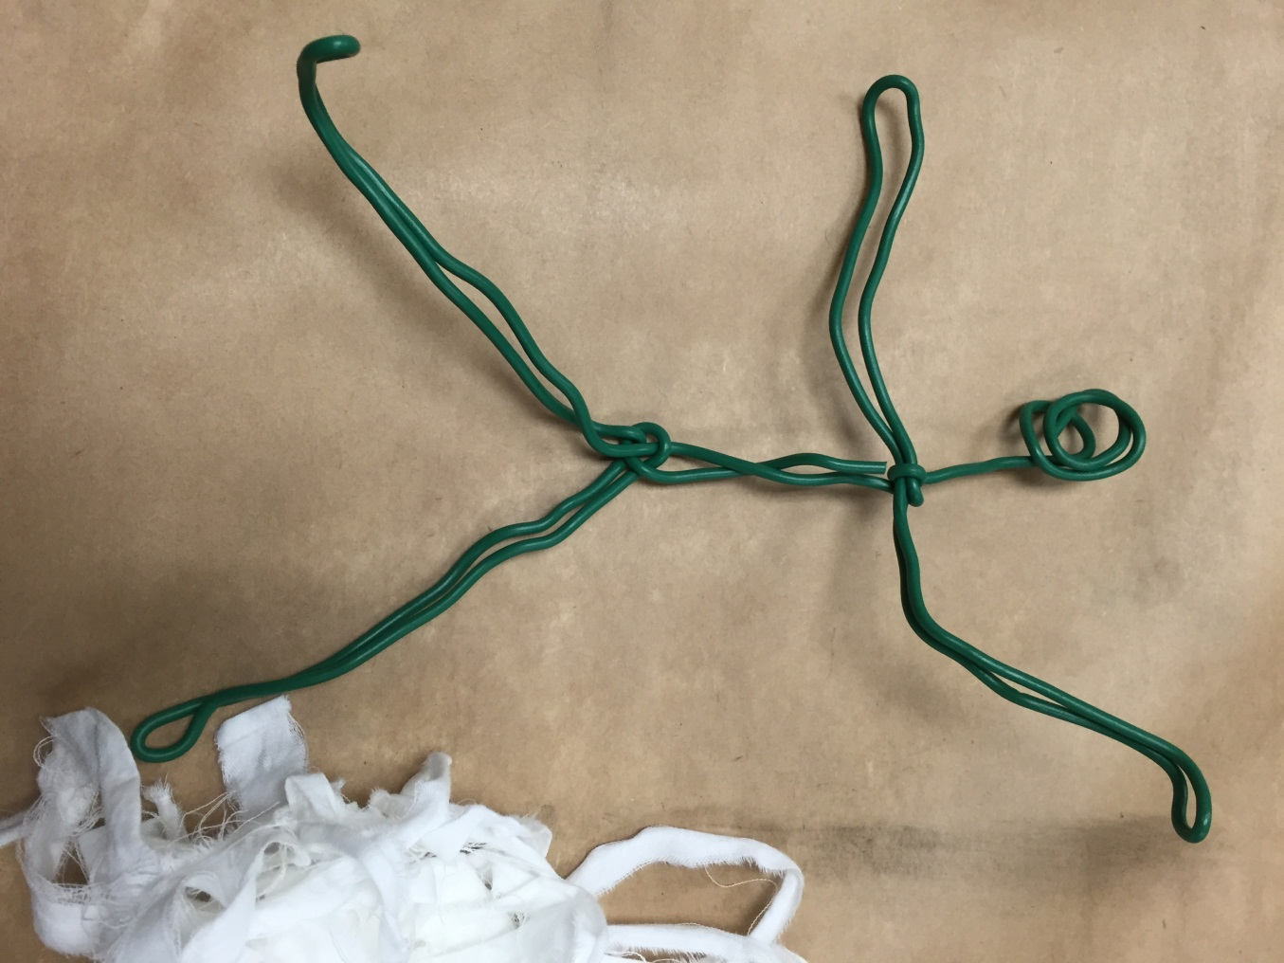
Start with a Wire Frame (about 3 feet long)

Slide 3
Cut Sheet Material into Strips Write a message on your first strip…

Slide 4
Start Wrapping in the Centre and work your way outward to limbs

Slide 5
Add layers by tying finished end to new strip of fabric Layer more in centre of body

Slide 6
Position Body When Finished

