Slide 1
What is art?
…or more importantly – what does Art have to do with us?

Slide 2
In Your Sketchbook
Write down this question:
What is Art?
Brainstorm possible answers to the question in your sketchbook. Write down or draw anything and everything that comes to mind.

Slide 3
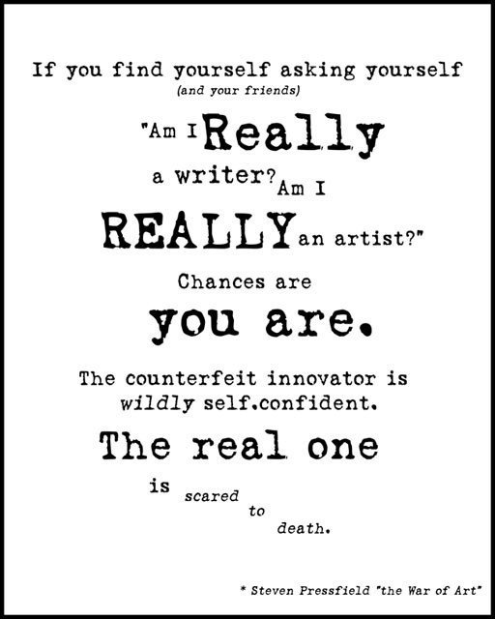
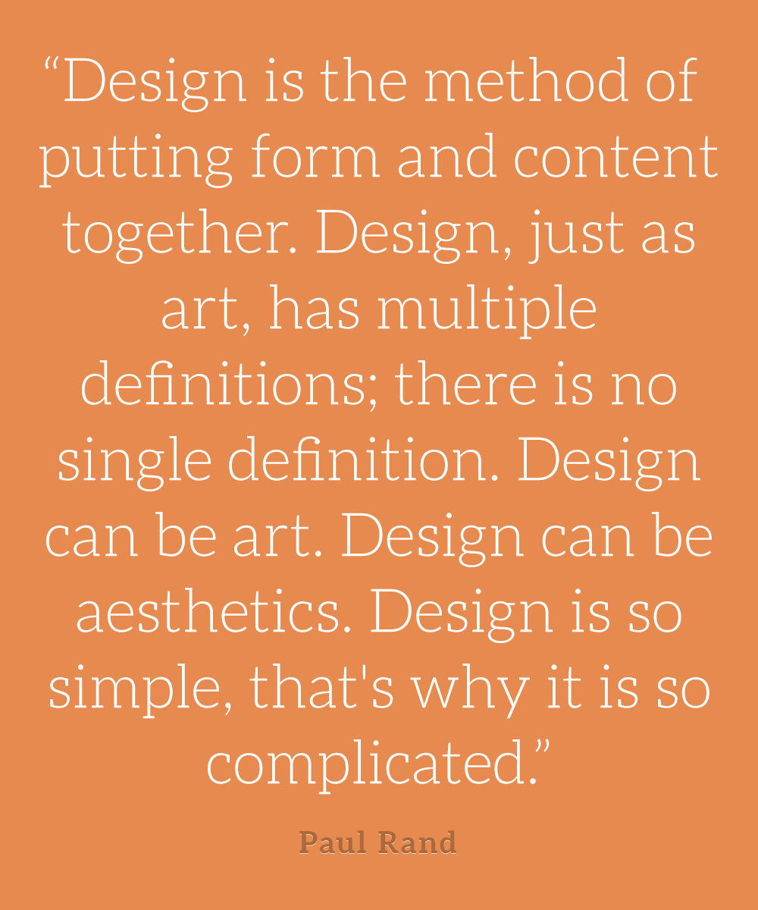
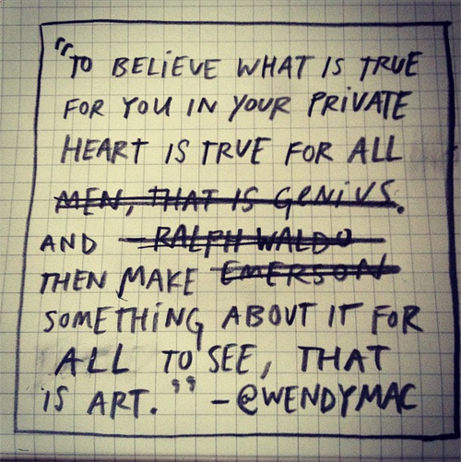
A Few Points of View on the Question

Slide 4
What is Art?
Not simply painting and drawing – has many definitions…
Art is a form of communication – a visual language – the visual expression of an idea, feeling or experience.
Art is about the process of perceiving, communicating and reflecting on an idea as much as it is about creating a product.
Art is created to communicate with ourselves and with the wider world.
Art speaks to us where words might fail.
Not simply for those few “talented” people – art stimulates our interests and appreciation for simplicity, uniqueness, original ideas, and their application.
Traditional techniques for art: drawing, painting, sculpting and printing are among the many ways people express a desire to work creatively.
Art includes activities and objects found in everyday life.

Slide 5
Course Goals and Curriculum Outcomes
Area 1 - Creating, Making and Presenting
You will explore, challenge, develop and express ideas using the language, techniques, and processes of Art.
You will create and/or present, collaboratively and independently, expressive products in the arts for a range of audiences and purposes.

Slide 6
Course Goals and Curriculum Outcomes
Area 2 - Understanding and Connecting Contexts of Time, Place and Community
You will demonstrate critical awareness of and value for the role of the arts in creating and reflecting culture.
Respect the contributions to the arts of individuals and cultural groups in local and global contexts, and value the arts as a record of human experience and expression.

Slide 7
Course Goals and Curriculum Outcomes
Area 3 - Perceiving, Reflecting and Responding
Apply critical thinking and problem-solving strategies to reflect on and respond to your own and others’ expressive work.
Understand the role of technologies in creating and responding to expressive works.
Analyze the relationship between artistic intent and the expressive work.

Slide 8
What is it to “Perceive” Art?
To perceive is to become deeply aware through the senses (sight, smell, touch, hear, taste) of the special nature of a visual object.
We attach meaning to what we perceive, or understand of the world around us.

Slide 9
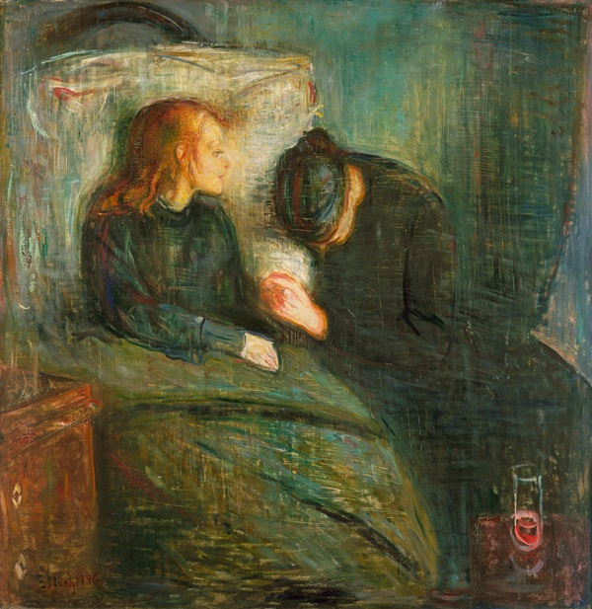
What is the Purpose of Art?
Personal Function – Artists create art to express personal feelings.
What feeling is Munch
conveying here?
Edvard Munch –
The Sick Child, 1885-6.

Slide 10
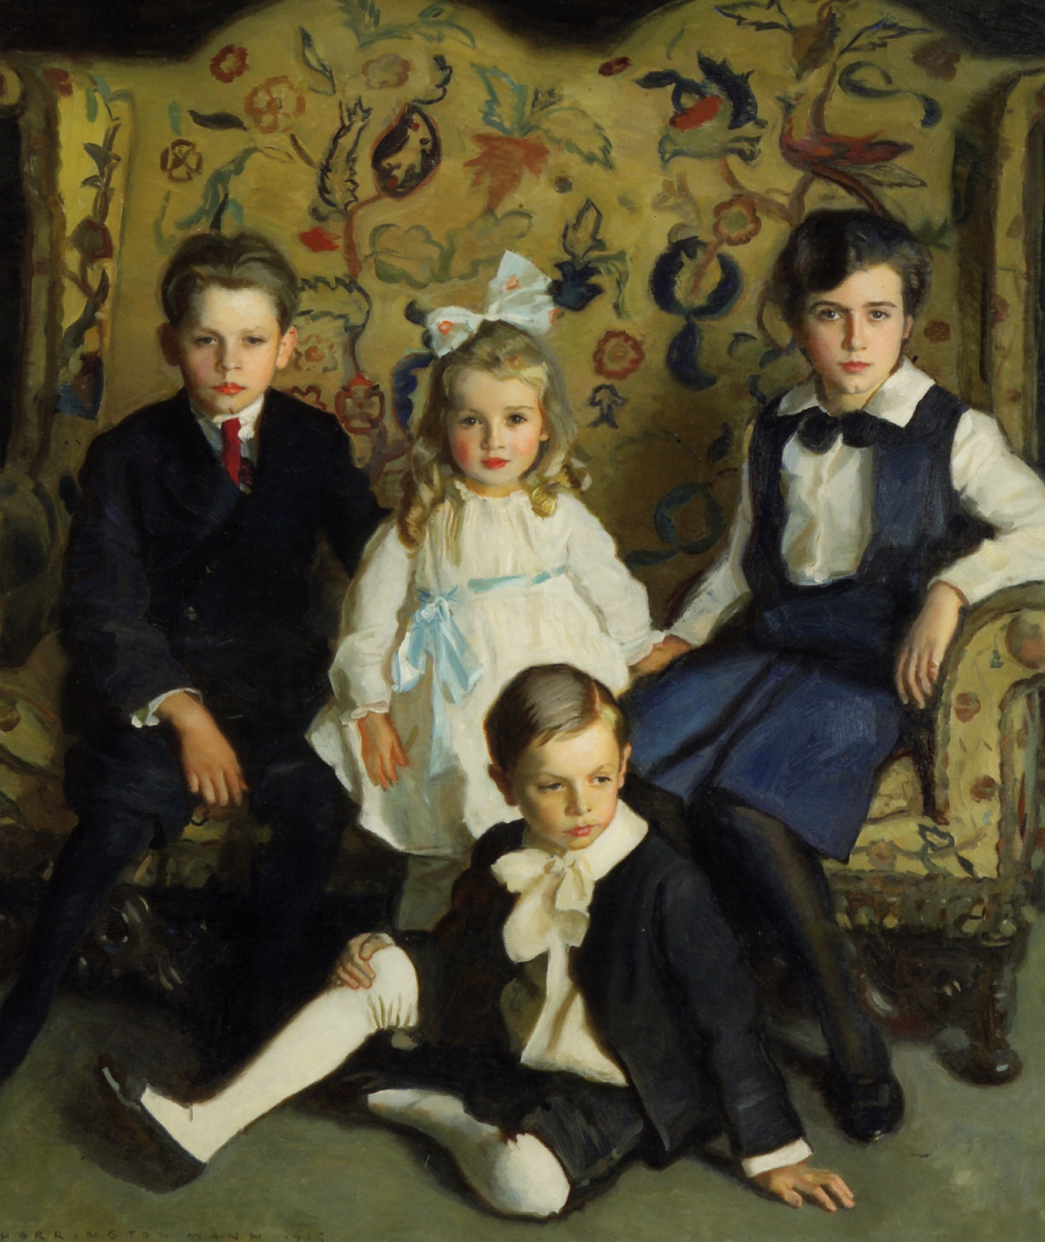
What is the Purpose of Art?
Social Function – Artists may produce art to reinforce and enhance the shared sense of identity to those in a family, community or culture. Think of family portraits.
Harrington Mann –
A Family Portrait of Four Children, 1915.

Slide 11
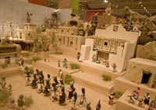
What is the Purpose of Art?
Spiritual Function – Artists create art to express spiritual beliefs about destiny of life or belief in a higher power.
Pueblo Scene: Corn Dancers and Church, 1960.

Slide 12
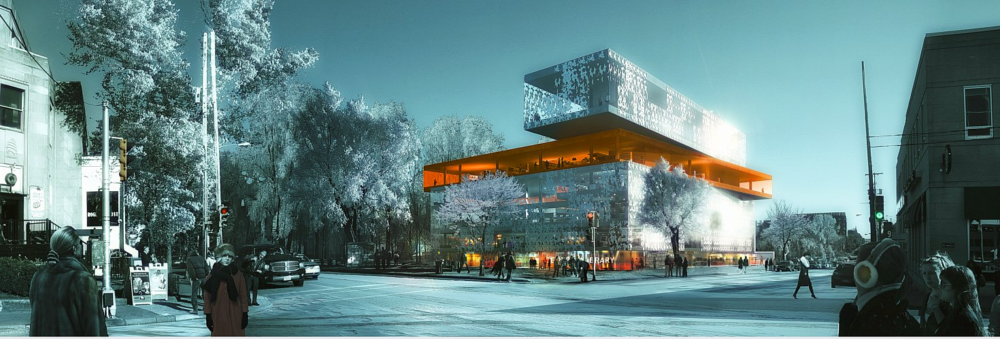
What is the Purpose of Art?
Physical Functions – Artists, craftspeople and designers constantly invent new ways to create functional art. Car designs, toothbrushes, building materials, all have practical use behind them – or function.
Halifax Central Library.

Slide 13
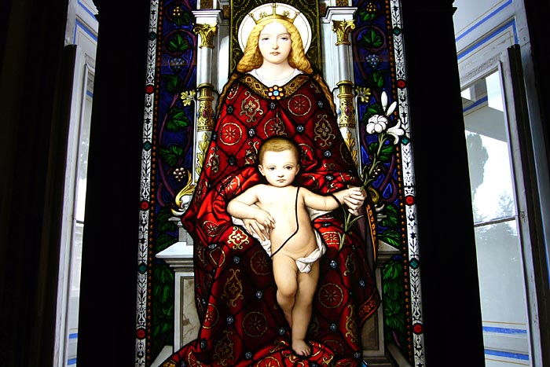
What is the Purpose of Art?
Educational Function – Prior to public education, many people could not read or write. Art was used as a visual tool to teach or share information with others.
Mother and Child –
Vatican Museum,
Sistine Chapel

Slide 14
What Are Some Other Purposes for Art?
In your sketchbook, brainstorm a list of possible purposes for your Art based on what we have learned so far.
Once you have made your list – answer the following question in your sketchbook:
In your opinion, why do people make art?

