Slide 1
Point of View
Mentor Texts

Slide 2
Point of View
Point of View: The author’s point of view concentrates on the vantage point of the speaker, or “teller” of the story or poem. This may be considered the poem’s “voice” — the pervasive presence behind the overall work. This is also sometimes referred to as the persona.
• 1st Person: the speaker is a character in the story or poem and tells it from his/her perspective (uses “I”).
• 3rd Person limited: the speaker is not part of the story, but tells about the other characters through the limited perceptions of one other person.
• 3rd Person omniscient: the speaker is not part of the story, but is able to “know” and describe what all characters are thinking.

Slide 3
Remember…
Remember that no text is neutral, so point of view is in poetry for a purpose - to reveal the poet’s stance on an issue.
Often point of view comes from personal experience – something that poet’s want to share with their audience.
We are going to look at poetry from the perspectives or POINTS of VIEW of 3 different writers.

Slide 4
For Elaine
Definition of 2nd Person Point of View:
In second person point of view, the narrator tells the story to another character using "you"; the story is being told through the addressee's point of view.
Second person is the least commonly used POV in fiction, though there are a few examples.
Tom Robbins's Half Asleep in Frog Pajamas is one example of a novel told in second person. Many of the stories in Lorrie Moore's book Self-Help are also written in the second person.
The following example of second person comes from her story "How to Become a Writer,":
The next semester the writing professor is obsessed with writing from personal experience. You must write from what you know, from what has happened to you. He wants deaths, he wants camping trips. Think about what has happened to you. in three years there have been three things: you lost your virginity; your parents got divorced; and your brother came home from a forest ten miles from the Cambodian border with only half a thigh, a permanent smirk nestled into one corner of his mouth.

Slide 5
Who was Langston Hughes?
African American poet.
Lived in Harlem, New York.
Writer during the Harlem Renaissance.
Pivotal in representing the Civil Rights movement during the 50s and 60s – first African American to achieve literary success.
Came from very modest beginnings, lived in a segregated community.

Slide 6
Hughes on the Topic of Racism
I swear to the Lord I still can't see Why Democracy means Everybody but me.
~Langston Hughes, The Black Man Speaks

Slide 7
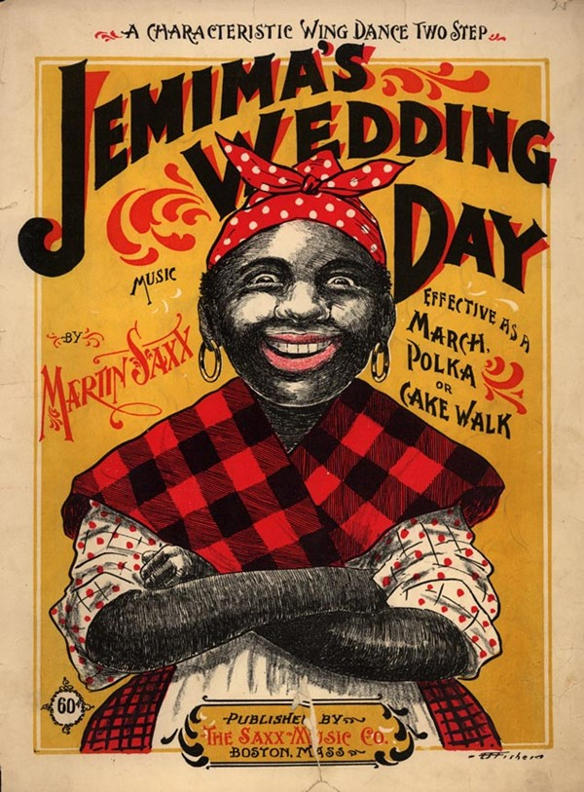
Aunt Jemima
http://en.wikipedia.org/wiki/Aunt_Jemima

Slide 8
Questions - Point of View
For each of the poems, answer the following questions, in FULL SENTENCES on looseleaf and pass in.
What is the title of this poem?
Who is the author of this poem?
What point of view is the poem written from (1st person, 3rd person limited, or 3rd person omniscient)?
What is the major issue or idea the poet is writing about?
Why do you think the poet felt it was important to share this idea with us?

