Slide 1
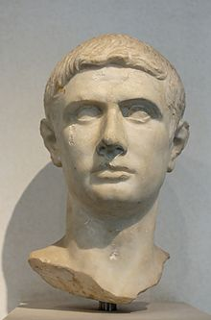
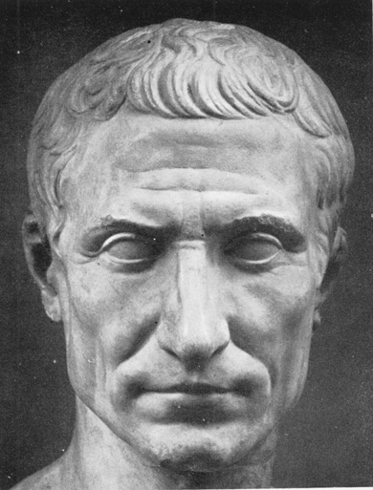
Julius Caesar

Slide 2
History of the Play
Shakespeare’s shortest play. Written and performed in 1599.
Likely to be one of the first, if not the first, play performed at the Globe Theatre.
Shakespeare’s main resource for writing the play was Thomas North’s translation of Plutarch’s Lives of the Noble Grecianes and Romans.
Julius Caesar is a deeply ambiguous play – not clear whether Caesar or Brutus (if either) is the tragic hero or chief protagonist. Critics and audiences alike also note and debate the ambiguous way in which Shakespeare has drawn his main characters showing both their admirable and distasteful aspects.

Slide 3
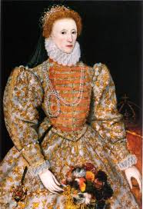
Historical Context
The play Julius Caesar is seen as an allusion to political strife in England at the time it was written.
Queen Elizabeth I had been on the throne 40+ years at this point – and had no known heir to the throne. There was a lot of controversy during her rule (“virgin queen”, assassination attempts, threats of war, etc.) and was expect that England would be thrown into upheaval upon her death.
Censorship prevented people from openly discussing the Queen or her possible successors in a play, so Shakespeare uses the story of Julius Caesar to make commentary on the issues of his day.
Queen Elizabeth I was known to attend
Shakespeare’s plays.
Handouts:
Where’s Where in Julius Caesar
When’s When in Julius Caesar

Slide 4
Setting of the Play
Play is set in the year: 44 BCE
Action takes place in Ancient Rome
“Situation” prior to the play:
Infighting between military leaders, politicians and senators of Rome
3 military leaders looking to gain ultimate control of Rome: Crassus (dies in battle in 53 BCE), Pompey and Caesar
Unlike other military leaders at the time, Caesar is popular with the general public.
Caesar crosses Rubicon River into Pompey (against advice of the Roman Senate) and declares civil war between Pompey and Rome in 53 BCE; Rome wins, Pompey killed in 48 BCE
46 BCE - Caesar is now appointed dictator of Rome (term job) – at the time Rome is a Republic (democracy) run by the Senate and Caesar
44 BCE - Caesar is appointed dictator for life - fear is that Caesar will dissolve the Senate and declare himself Emperor of Rome, making it an Empire (not a democracy)

Slide 5
5 Main Themes
1. Loyalty
Betrayal of loyalty between individuals
Loyalty to individuals
2. Beauty and the Beast
Ambition and Nobility (tragic flaws)
3. Power
Emperor or Senate?
4. Diversity
5. Hero Journey
Caesar vs. Brutus

Slide 6
General Text Features in Plays
Table of Contents
Headings and Titles
Introduction to the Play
Characterization List
Overview or Synopsis for the Play
Synopsis for each Act
Notations on the sides of each page

Slide 7
Notation Features in Plays
Plays are divided into Acts. Most Shakespearean plays have 5 acts in them.
Acts are further divided into Scenes. Acts usually have 5 scenes in each, give or take.
Scenes are further divided into Lines. Each line is marked, lines are counted by 5s.
Numbering of acts and scenes are usually done in Roman Numerals. I = 1, II = 2, III = 3, IV = 4, V = 5, VI = 6, etc.
So if I tell you to look at Act 3, scene 2, line 21 (III.ii.21) – what page would you be on in your text?
Act (I - V) – usually marked with capitals
Scene (i - v) – usually marked with lower case numerals
Line (#1,2,3,4 ….) – numbers used instead of roman numerals

Slide 8
Characterization
See pages xxvi-xxvii – Julius Caesar
See handout:
Sparknotes: Characters
Online at:
http://www.sparknotes.com/shakespeare/juliuscaesar/characters.html

Slide 9
Act 1 - Synopsis
Civil War – Rome vs. Pompey
Pompey defeated by Caesar
Play is about division (political and personal)
Caesar is deaf
Major ideas:
Cobbler – joke “Mender of bad soles (souls)”.
Ides of March – pathetic fallacy regarding weather in Act 1 scene 3
Conspiracy – Brutus and friends planning to take out Caesar
Loyalty

Slide 10
Poetry, Prose, and Puns
Complete and pass in the handout Poetry, Prose, and Puns after Reading Act 1, Scene 1.
Complete the Study Questions for Act 1 after reading Act 1.

