Slide 1
Drama Through the Ages

Slide 2
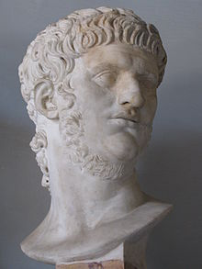
Roman Tragedy
1st century AD
Nero was Emperor
Seneca: wrote Medea →
closet audience Nero
and friends

Slide 3
4 Main Flaws in Roman Tragedy
Plots were unrealistic (too exaggerated)
Melodramatic → more horror tragedy
Stoic → capacity to ENDURE →preach sermons
Poor elaborate poetry → Quantity OVER Quality

Slide 4
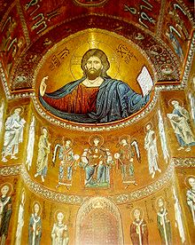
Medieval “Dark Ages” Period
500 - 1100 AD – Middle Ages
X = Christ = XPISTOS
Christian = Xian
Xian Church:
Architecture
Painting/Sculpture
Reading and Writing
Drama → to teach bible stories
→ explain religious ideas

Slide 5
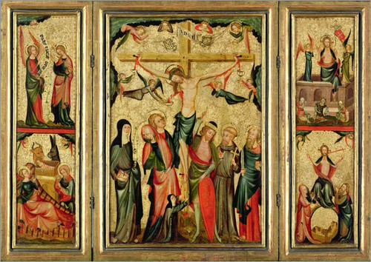
Mass sung in Latin: - Liturgy
Easter
→Act out story so people would understand because they
didn’t understand Latin.
→Couldn’t read or write
→ Pre printing press

Slide 6
Two kinds of Xian Play
Miracle Play → Retell Bible stories
Noah: Guild of Shipbuilders
Guild plays - became secularized (worldly)
Morality Play → Moral dilemma
Choose good, be rewarded in Heaven
Bad, be punished in Hell
→ Good guy brings bad guy to JUSTICE; gets his reward. The audience learned to tag people with moral positions.

Slide 7
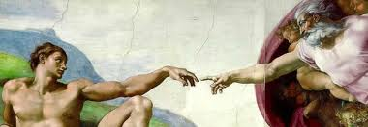
Renaissance Period
1200-1500 AD
Rebirth; renewal
Rediscovery of Roman/Greek culture
Transcribed LATIN manuscripts
Early Renaissance writers copied Roman models – especially REVENGE TRAGEDY.

Slide 8
Revenge Tragedy
A Kills B
C Kills A
Avenge – seek revenge
Seeker becomes a murderer and corrupt
The need for revenge leads to corruption
Corruption leads to ruin – Hamlet
England → early tragedy poor – Roman model

Slide 9
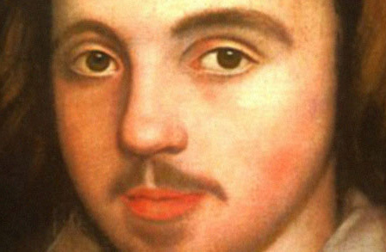
Christopher Marlowe (1564-1593)
Copied Greek texts – wrote:
Tambourlaine
political ambition/loss empire
rebelliousness = ruin
Jew of Malta
Greed and desire for revenge = ruin
Dr. Faustus
Alchemist - “magic” formula
Ambition for knowledge leads to ruin
Edward II
Homosexuality = loss of a kingdom

Slide 10
Marlowe
Marlowe knew Greek pattern
Marlowe established the rule that English drama must be written in poetry
Blank verse: iambic pentameter with no rhyme

Slide 11
Iambic Pentameter
Iamb → French = jamb = leg = walking meter
Iamb unstressed + stressed
walk | ing
Penta = greek 5
1 2 3 4 5
And there | in mire | and pud|dle did | I stand

