Slide 1
Aristotle’s Rules of Tragic Plot

Slide 2
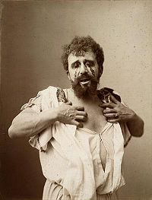
Oedipus Rex
Written by Sophocles in 429 BCE.
Play about excess – human folly in arrogance and pride.
Hubris ( /ˈhjuːbrɪs/), also hybris, from ancient Greek ὕβρις, means extreme pride or arrogance. Hubris often indicates a loss of contact with reality and an overestimation of one's own competence or capabilities, especially when the person exhibiting it is in a position of power.
Brief Explanation of the Play –
http://www.youtube.com/watch?v=oXyek9Ddus4&list=PLLnUvSVi648VUKy16b1Q_0RkA3CfZPDs1
Herdsman Scene –http://www.youtube.com/watch?v=8Gtw9zKb7wA&feature=related

Slide 3
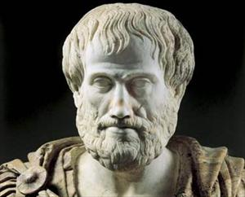
Aristotle 384-322 BCE.
Aristotle, in his Poetics, considered Oedipus Rex to be the perfect tragedy, and be the model on which all tragedy should be written.
In Poetics, Aristotle developed rules for tragedy that have been used to write plays ever since.

Slide 4
Aristotle’s Rules of Tragic Plot
Your task:
Write a 200-300 word tragic scene following Aristotle’s Rules of Tragic Plot.
Due: ______________________

